Slide 1

Lesson 1.3
Media Impact on Industry Growth
Copyright © 2017 by Sports Career Consulting, LLC

Slide 2
History of SEM
LESSON 1.3
Media Impact on Industry Growth
Media refers to a means of communicating a message to large numbers of people
Copyright © 2017 by Sports Career Consulting, LLC

Slide 3
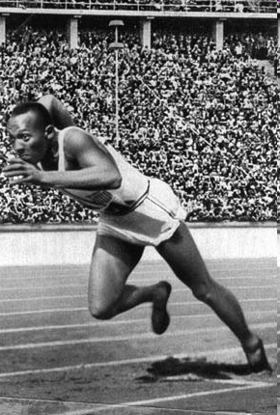
History of SEM
LESSON 1.3
Media Impact on Industry Growth
It was not until the 1936 Olympics (broadcast by ABC radio) that Americans were truly exposed to the amazing talents of Jesse Owens, one of America’s greatest athletes of all time
Copyright © 2017 by Sports Career Consulting, LLC

Slide 4
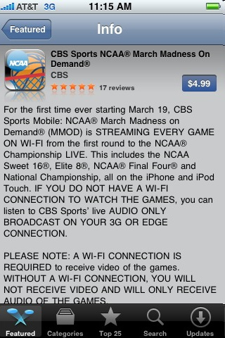
History of SEM
LESSON 1.3
Media Impact on Industry Growth
Now, fans can follow athlete performances live through television, radio, Internet as well getting information through national papers, local papers, magazines, and industry specific journals
Copyright © 2017 by Sports Career Consulting, LLC

Slide 5
History of SEM
LESSON 1.3
Media Impact on Industry Growth
Media rights (or broadcast rights) are fees paid by broadcast companies to sports or entertainment properties for the opportunity to provide live coverage of the property’s games and events on television, the radio or the Internet
Copyright © 2017 by Sports Career Consulting, LLC

Slide 6
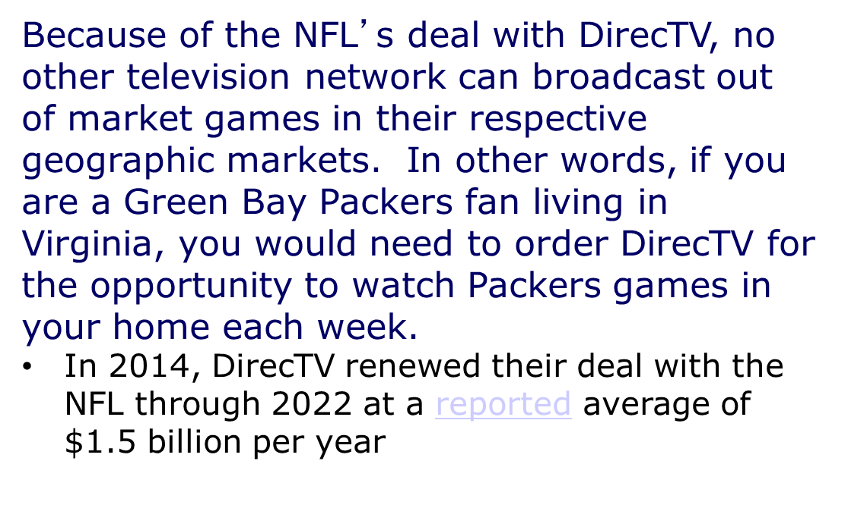
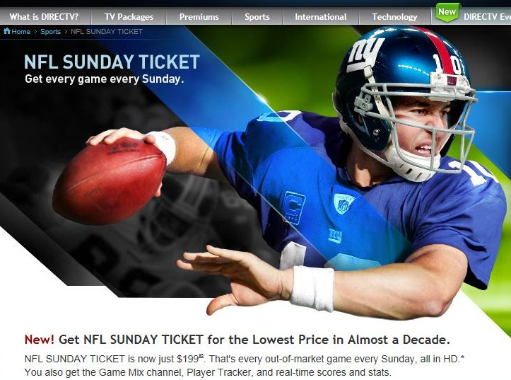
History of SEM
LESSON 1.3
Media Rights
Many media rights deals provide exclusive coverage rights
Copyright © 2017 by Sports Career Consulting, LLC

Slide 7

History of SEM
LESSON 1.3
Media Rights
Nearly ten years after Comcast Sports Northwest (a cable television provider who also owns a regional sports network) partnered with the Portland Trail Blazers for exclusive TV distribution rights, nearly 50% of fans in the Portland area still cannot watch Blazers games if they are DirecTV or Dish subscribers.
Copyright © 2017 by Sports Career Consulting, LLC

Slide 8
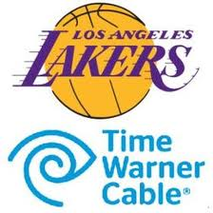
History of SEM
LESSON 1.3
Media Rights
Media rights contracts are not reserved for national broadcasting companies as sports franchises work to maximize revenues by selling regional broadcasting rights to regional partners, in addition to generating revenue through national broadcast deals.
Time Warner Cable paid a reported $3 billion for exclusive rights to broadcasts Los Angeles Lakers games in the L.A. market through the 2032-33 season
Copyright © 2017 by Sports Career Consulting, LLC

Slide 9

History of SEM
LESSON 1.3
Media Rights
Rights fees have grown at a rapid rate
Media rights fees for the Rose Bowl (per year) were $2 million in 1974, $30 million in 2012, and reached $80 million annually when ESPN inked an 11 year deal in 2015.
Copyright © 2017 by Sports Career Consulting, LLC

Slide 10
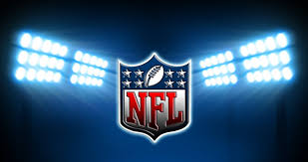
History of SEM
LESSON 1.3
Media Rights
According to Plunkett Research, today the NFL generates over $6 billion annually from their contracts with major television stations and providers.
To put that in perspective, the NFL earned $2.4 million in broadcast rights in 1960 (adjusted for inflation, that’s $19.4 million today).
Copyright © 2017 by Sports Career Consulting, LLC

Slide 11

History of SEM
LESSON 1.3
Media Rights
Why are media rights important to sports and entertainment properties?
In a word…
REVENUE!
Copyright © 2017 by Sports Career Consulting, LLC

Slide 12

History of SEM
LESSON 1.3
Media Rights
NASCAR generates a reported $820 million annually in media rights for television broadcasts from Fox, a 46% increase from the previous deal.
Copyright © 2017 by Sports Career Consulting, LLC

Slide 13

History of SEM
LESSON 1.3
Media Rights
According to the Chicago Tribune, a dispute over the value of the Chicago Cubs’ broadcast contracts complicated efforts to sell the iconic franchise.
Because media rights are such an important piece to any major league sports organization’s bottom line, negotiations to sell the franchise momentarily fell apart until the issue could be resolved.
Copyright © 2017 by Sports Career Consulting, LLC

Slide 14

History of SEM
LESSON 1.3
Media Rights
According to Nielsen (a company who measures ratings): "Ratings are used like currency in the marketplace of advertiser-supported TV. When advertisers want a commercial to reach an audience, they need to place it in TV programs which deliver an audience. The more audience a program delivers, the more the commercial time is worth to advertisers."
Copyright © 2017 by Sports Career Consulting, LLC

Slide 15
History of SEM
LESSON 1.3
Media Rights
Why are media rights important to broadcast companies?
Companies want to invest in advertising that will reach as many consumers as possible and sports and entertainment events provide an effective platform for advertisers to do that
Copyright © 2017 by Sports Career Consulting, LLC

Slide 16
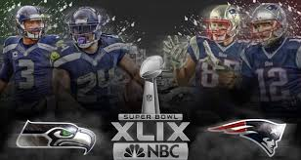
History of SEM
LESSON 1.3
Media Rights
In 2015, the Super Bowl set a record for American television viewing when the Nielsen Co. estimated 114.4 million people watched the New England Patriots’28-24 thrilling victory over the Seattle Seahawks.
Copyright © 2017 by Sports Career Consulting, LLC

Slide 17
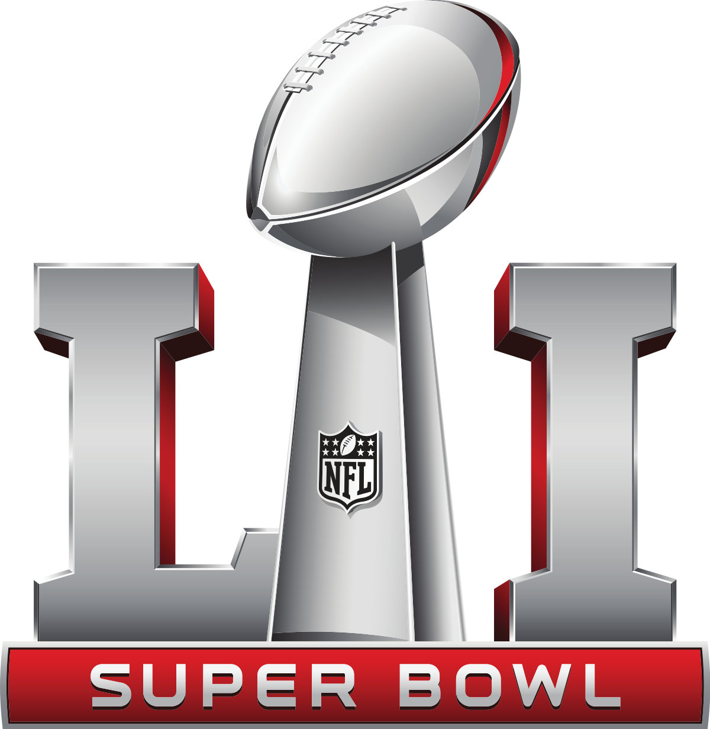
History of SEM
LESSON 1.3
Media Rights
Super Bowl 51, played in 2017 between the New England Patriots and Atlanta Falcons drew the fourth largest audience in TV history with more than 111 million viewers while setting a new streaming record with an average of 1.7 million viewers per minute
Copyright © 2017 by Sports Career Consulting, LLC

Slide 18

History of SEM
LESSON 1.3
Media Rights
According to figures released by FIFA, more than one billion fans tuned in to watch the 2014 World Cup in Brazil –the games reached 3.2 million in-home television viewers, and another 280 million watched matches online or on a mobile device –a record setting 695 million fans tuned in for the final game, which is a 12% increase from 2010.
Copyright © 2017 by Sports Career Consulting, LLC

Slide 19

History of SEM
LESSON 1.3
Media Rights
According to the research firm Kantar Media, advertisers have spent $4.55B during CBS' coverage of the men's NCAA basketball tournament over the past decade
Copyright © 2017 by Sports Career Consulting, LLC

Slide 20

History of SEM
LESSON 1.3
Media rights examples
Network/Cable TV
The NBA recently extended its deals with TNT, ESPN and ABC through the 2024-25 season, generating over $2.66 billion per year in revenue for television broadcast rights (more than double what the league earned through its previous rights deal).
As a result, teams now have more money than ever to spend on payroll, and player salaries will increase exponentially.
Copyright © 2017 by Sports Career Consulting, LLC

Slide 21


History of SEM
LESSON 1.3
Media rights examples
Network/Cable TV
NBC won a bidding war to retain its rights to broadcast the Olympic Games through 2020 for $4.38 billion.
ESPN signed a deal reportedly worth nearly $500 million for the exclusive broadcast rights of Wimbledon through 2023
Copyright © 2017 by Sports Career Consulting, LLC

Slide 22
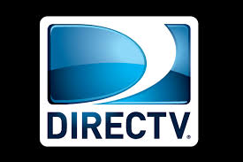
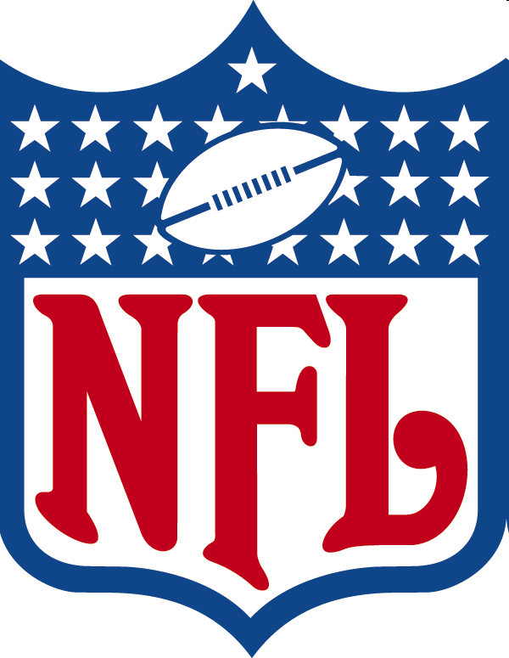
History of SEM
LESSON 1.3
Media rights examples
Satellite TV
DirecTV’s exclusive agreement for broadcast rights for out of market NFL games was extended in 2014 for eight years at a reported$1.5 billion per year (a 50% increase on an annual basis over the previous deal).
Copyright © 2017 by Sports Career Consulting, LLC

Slide 23

History of SEM
LESSON 1.3
Media rights examples
Satellite Radio
Reuters suggested in an online news story that Sirius satellite radio has invested “ billions” on rights to the NFL, NBA, NASCAR.
Copyright © 2017 by Sports Career Consulting, LLC

Slide 24
History of SEM
LESSON 1.3
Media rights examples
Network Radio
In 2009, the NFL extended its deal with Westwood One as its exclusive network radio partner in a deal worth over $30 million
Copyright © 2017 by Sports Career Consulting, LLC

Slide 25

History of SEM
LESSON 1.3
Media rights examples
Multimedia rights
Within the 17 months of acquiring Host Communications and folding it into its college division, IMG invested more than $700 million in multimedia rights fees
Copyright © 2017 by Sports Career Consulting, LLC

Slide 26
History of SEM
LESSON 1.3
Media Impact on Industry Growth
Radio, cable and broadcast television programming measure their effectiveness through ratings, which are expressed as a percentage of the potential TV audience viewing at any given time
Copyright © 2017 by Sports Career Consulting, LLC

Slide 27
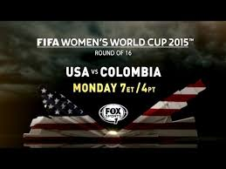
History of SEM
LESSON 1.3
Media Rights
Basically, a rating refers to the number of households or people tuned into a particular radio or television program at a specific time
FOX Sports 1’s telecast of the United States Women’s 2-0 win over Colombia in the 2015 FIFA World Cup was the network’s most-viewed soccer match ever, attracting 4.7 million viewers (also making it the third most-watched in FOX Sports 1 history).
Copyright © 2017 by Sports Career Consulting, LLC

Slide 28
History of SEM
LESSON 1.3
Media Rights
Nielsen can identify peak hours in which the most people are tuned in to watch or listen
Viewing of the US vs. Colombia World Cup match peaked from 9:30 to 9:45 p.m. ET
Copyright © 2017 by Sports Career Consulting, LLC

Slide 29
History of SEM
LESSON 1.3
Media Rights
Nielsen can also identify specific markets in which ratings were the highest
St. Louis led all markets for ESPN’s USA vs. Colombia telecast with a 5.3 rating, followed by Washington, D.C. (5.0), Philadelphia (4.9), Orlando (4.4) and Norfolk (4.3)
Copyright © 2017 by Sports Career Consulting, LLC

Slide 30
History of SEM
LESSON 1.3
Media Rights
Why are ratings important?
Without ratings, broadcast companies would have a difficult time selling advertising and sports/entertainment programs would not be able to command million dollar rights fees
Ratings will fluctuate from year to year, but a ratings increase or decrease will have an impact on the sports property and broadcast company
Copyright © 2017 by Sports Career Consulting, LLC

Slide 31

History of SEM
LESSON 1.3
Media Rights
When NBC renewed its hockey deal (at a cost nearly triple the previous rights deal), the decision was heavily influenced by the fact that overall NHL television ratings in the United States had increased by 84 percent over the last four years.
Copyright © 2017 by Sports Career Consulting, LLC

Slide 32
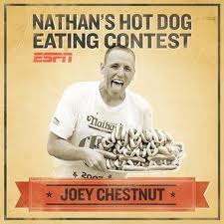
History of SEM
LESSON 1.3
Media Rights
After the previous year’s July 4th telecast of the Nathan’s Famous Fourth of July International Hot Dog Eating Contest set a viewership record with nearly 2 million live viewers, ESPN announced in the summer of 2012 that they extended the broadcast rights deal through 2016
ESPN extended the deal Major League Eating (parent company of the Fourth of July International Hot Dog Eating Contest) again in 2014 for ten years, guaranteeing the rights to broadcast the annual event on its various platforms through 2024
Copyright © 2017 by Sports Career Consulting, LLC

Slide 33

History of SEM
LESSON 1.3
Media Milestones in Sports
1921 - First ever baseball game broadcast on radio
1935 - First full season baseball broadcast on radio (Chicago Cubs)
1946 - First major sports event on TV
(Joe Louis Boxing Match)
Copyright © 2017 by Sports Career Consulting, LLC

Slide 34
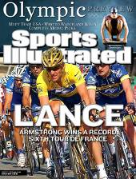

History of SEM
LESSON 1.3
Media Milestones in Sports
1954 - Sports Illustrated introduced
1970 - First Monday Night Football TV broadcast
Copyright © 2017 by Sports Career Consulting, LLC

Slide 35
History of SEM
LESSON 1.3
Media Milestones in Sports
1995 – DirecTV and the NFL offer first subscriber
based pay-per-view programming
(NFL Sunday Ticket)
1999 – Major League Baseball broadcasts the World
Series on the Internet
2002 – The pay-per-view boxing match between Mike
Tyson and Lennox Lewis generates a record
$103 million in sales
Copyright © 2017 by Sports Career Consulting, LLC

Slide 36
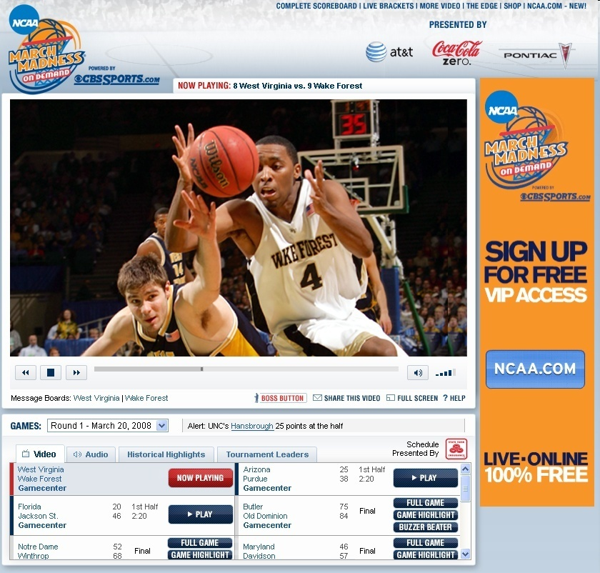
History of SEM
LESSON 1.3
Media Milestones in Sports
2009 – CBS’ free online broadcast of the 2009 Men’s
NCAA Tournament reaches an audience of 7.5
million
Copyright © 2017 by Sports Career Consulting, LLC

Slide 37
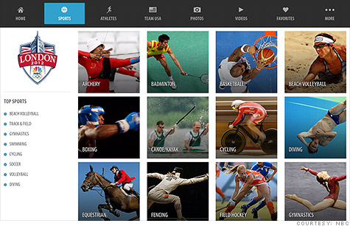
History of SEM
LESSON 1.3
Media Milestones in Sports
2012 – NBC provides unprecedented LIVE coverage of
EVERY Olympic event by streaming content
online in addition to its traditional television
coverage
Copyright © 2017 by Sports Career Consulting, LLC

Slide 38



History of SEM
LESSON 1.3
Media Impact on Industry Growth
In the early days of team sports, revenue came from:
Ticket Sales
Concessions
Copyright © 2017 by Sports Career Consulting, LLC

Slide 39
History of SEM
LESSON 1.3
Media Impact on Industry Growth
Today, media provides alternate revenue sources
National Television Contracts
Local Television Contracts
Cable Television Contracts
Sale of Radio Rights
Streaming Internet Audio
Online Revenue
Team Specific Publications
Copyright © 2017 by Sports Career Consulting, LLC

Slide 40
History of SEM
LESSON 1.3
Media Impact on Industry Growth
Sports and entertainment business coverage has become widespread and easily accessible
National publications devote consistent coverage to the business of sports
A Portland, Oregon radio station offers a weekly, hour-long sports business talk show (Sports Business Radio) that is nationally syndicated and carried on Sirius satellite radio
Today, local newspapers all around the country offer readers sports business related coverage on a regular basis on their websites
Copyright © 2017 by Sports Career Consulting, LLC

